Slide 1
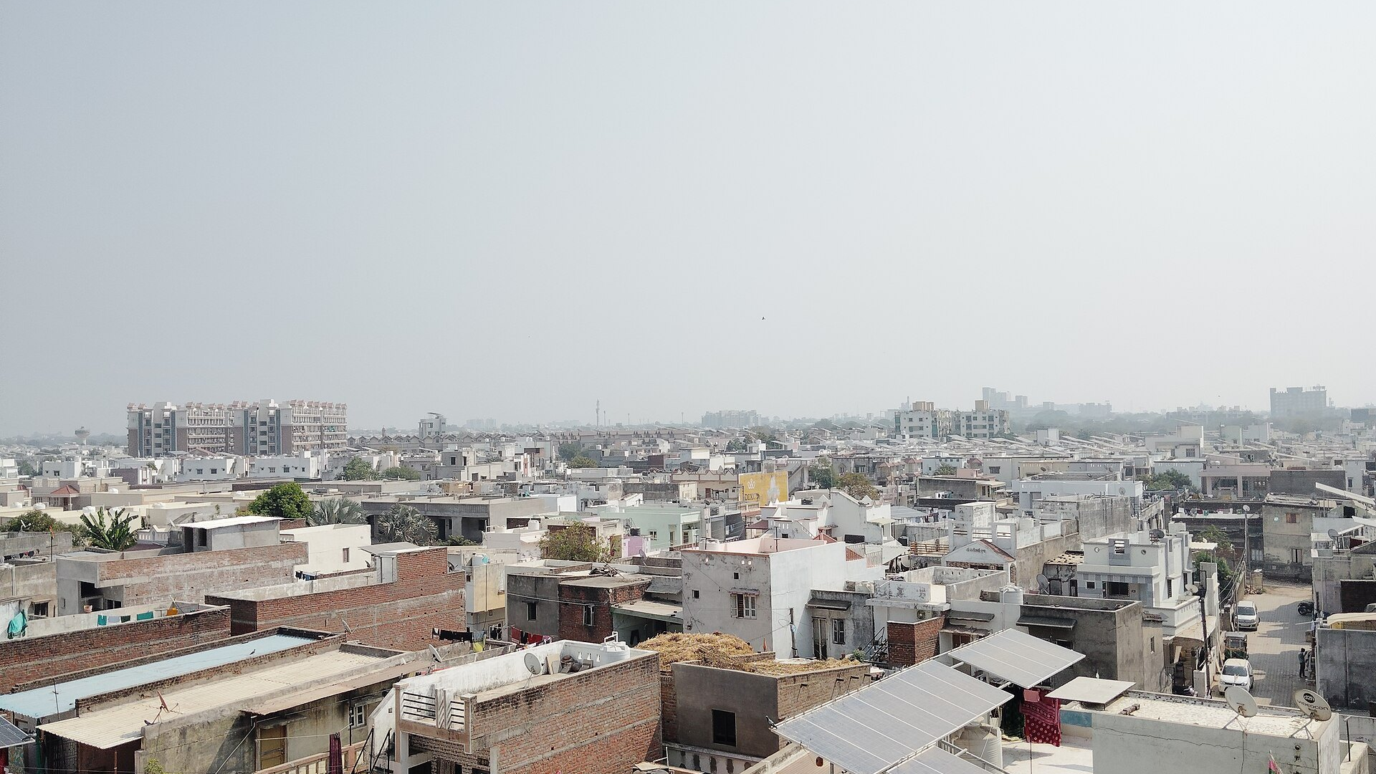
SOLAR MICRO-GRID
Suraj Grid
From 0 to 100 Villages in 3 Years — Powering Rural India One Rooftop at a Time
Photo: "Rooftop Solar panels on homes in Mehsana, Gujarat, India.jpg" by Nizil Shah, CC BY-SA 4.0
Notes:
Suraj Grid brings reliable, affordable solar electricity to rural villages that have lived in darkness for generations. We lead with our most impressive projection: 100 villages deployed within three years through word-of-mouth-driven growth. This is not just about power — it's about transforming lives, enabling education, economic opportunity, and safety after sunset. Today I'll show you how we're building the infrastructure that will light up 300 million lives across India.
Photo: "Rooftop Solar panels on homes in Mehsana, Gujarat, India.jpg" by Nizil Shah, CC BY-SA 4.0 (https://commons.wikimedia.org/wiki/File:Rooftop_Solar_panels_on_homes_in_Mehsana,_Gujarat,_India.jpg)

Slide 2
“
When the sun sets, everything stops.
Rural household survey, Rajasthan 2023
Notes:
300 million Indians lack reliable electricity — more than the entire population of the United States. In villages without grid power, life is constrained by daylight. Children cannot study after dark. Women cannot work evening shifts. Medical emergencies at night become life-threatening. Diesel generators are expensive, polluting, and unreliable. This quote captures the lived reality: electricity is not a luxury — it's the foundation for education, safety, economic mobility, and dignity. Suraj Grid exists to break this cycle.

Slide 3




THE PROBLEM
Market Gap: The Scale of the Opportunity
650K
$22B
6-8h
300M
Villages Underserved
Addressable Market
Daily Outages
People Affected
IAEA/MNRE data on villages lacking reliable grid access
Illustrative estimate of rural solar micro-grid market potential
Average rural grid downtime — illustrative estimate
Illustrative estimate based on village population data
Suraj Grid: Pitch Deck
3
Notes:
The scale of India's rural energy gap is staggering: 650,000 villages still lack reliable grid access according to IAEA and MNRE data. This represents a $22B addressable market opportunity for distributed solar solutions. Even villages with nominal grid connection suffer 6-8 hours of daily outages — forcing families into expensive, polluting diesel generators or complete darkness. The human dimension: 300 million people live in this energy limbo every single day.

Slide 4



THE SOLUTION
How It Works: End‑to‑End Micro‑Grid Architecture
Charge Controller
Regulates power flow
Solar Array
PV panels capture sunlight
Battery Bank
Stores energy for nights
Smart Distribution Box
Meters & routes power
Village Endpoints
Homes, shops, pumps
Cloud Dashboard
Remote monitoring
A complete solar micro‑grid system — from sunlight to village homes, with cloud‑based oversight for reliability and maintenance.
Suraj Grid: Pitch Deck
4
Notes:
This diagram shows the full Suraj Grid stack, from solar array to endpoints, with cloud dashboard for remote monitoring.

Slide 5
THE SOLUTION
Adoption Curve: 3-Year Village Rollout
KEY TAKEAWAY
From 2 villages in Q1 to 100 by end of Year 3 — compounding word-of-mouth growth (illustrative projection).
Suraj Grid: Pitch Deck
5
Notes:
This chart shows our projected village deployment ramp-up over three years. We start conservatively with two pilot villages in the first quarter, focusing on perfecting installation and customer support. Success in these pilots triggers a referral effect — satisfied village champions become our best salespeople. By Q4 of year one, we're deploying to 18 villages. Growth accelerates in year two as our operational team scales and supply chain efficiencies kick in, hitting 48 villages by Q6. The third year is where compounding really shows: we cross 100 total villages by Q8, powered entirely by word-of-mouth and proven local credibility. This trajectory is ambitious but grounded in similar solar mini-grid rollouts across Sub-Saharan Africa and South Asia.

Slide 6



THE SOLUTION
Business Model: Three Revenue Streams
Pay-As-You-Go
₹10-20/day via UPI/SMS, no upfront cost — villagers only pay for what they use, building a recurring revenue stream tied directly to consumption and adoption.
Government Subsidies
MNRE & state DISCOMs co-fund installation up to 40%, reducing capital expenditure and making our system pricing competitive with diesel generators while aligning with national electrification goals.
Carbon Credits
Verified emission reductions sold on voluntary markets at ~$8/tonne — each 100-village cluster generates ~1,200 tonnes CO₂ avoidance annually, adding ~$9,600 in non-tariff revenue per cluster.
Suraj Grid: Pitch Deck
6
Notes:
Our business model is built on three sustainable revenue streams that align with village economics and government priorities. First, Pay-As-You-Go eliminates the upfront barrier that has stalled rural electrification for decades — villagers pay just ₹10-20 per day via UPI or SMS for the electricity they actually use, with no capital expenditure required. Second, government subsidies from MNRE and state DISCOMs covering up to 40% of installation costs significantly de-risks the capital outlay and makes our pricing competitive with diesel. Third, carbon credits from verified emission reductions provide additional revenue without affecting villagers — each 100-village cluster generates roughly 1,200 tonnes of CO₂ avoidance annually, worth ~$9,600 at current voluntary market prices. Together, these three streams create a resilient, scalable business that grows as impact grows.

Slide 7




BEFORE VS. AFTER
Impact: Light Changes Everything
+4.2h
68%
−35%
1.2t
Extra Study Time per Child
Rise in Women-Led Micro-Business
Household Energy Spend vs. Diesel
CO₂ Avoided per Village per Year
Illustrative estimate — kerosene lamp → LED lighting extends usable evening hours
Illustrative estimate — evening hours unlock tailoring, food prep, mobile charging shops
Illustrative estimate — solar micro-tariff vs. ₹60-80/litre diesel generator costs
Illustrative estimate — displacing kerosene lamps and diesel gensets
Suraj Grid: Pitch Deck
7
Notes:
These four before-vs-after contrasts capture the human transformation that electricity delivers. Study time: children currently lose the entire evening to darkness; LED lighting from Suraj Grid adds an estimated 4.2 usable hours. Women's enterprise: reliable power enables tailoring, food processing, and phone-charging businesses that were impossible after sunset — we project a 68% increase in women-led micro-business formation within 12 months of installation. Cost: households currently spend ₹60-80/litre on diesel; our pay-as-you-go solar tariff cuts that bill by roughly 35%. Environment: each village displacing kerosene and diesel avoids an estimated 1.2 tonnes of CO₂ annually. All figures are illustrative estimates based on comparable deployments in Sub-Saharan Africa and South Asia; actual impact measurement is built into our Cloud Dashboard from day one.

Slide 8




IMPLEMENTATION
Path to Impact
Site Assessment
Solar Installation
Monitoring & Support
Scale & Replicate
Identify villages and energy needs
Deploy LED kits and micro‑grids
Track usage via Cloud Dashboard
Expand to neighboring communities
Suraj Grid: Pitch Deck
8
Notes:
Four-step roadmap for deployment.

Slide 9

Join the Light Revolution
Seed Round: $2M — 50 Villages, 25,000 Lives by 2026.
invest@surajgrid.in | surajgrid.in
Photo: "North Block, Indian Parliament, New Delhi.jpg" by Apsie1983, CC BY-SA 4.0
Notes:
Invite investors to join the Seed Round and scale impact across rural India.
Photo: "North Block, Indian Parliament, New Delhi.jpg" by Apsie1983, CC BY-SA 4.0 (https://commons.wikimedia.org/wiki/File:North_Block,_Indian_Parliament,_New_Delhi.jpg)

